Slide 1
Intellaturbine
Sponsor/mentor: Shaun Dunbar
Group 9
Dwayne Smith
Joaquim Thompson
Jose Dominguez
Timothy Knob

Slide 2
Motivation
Functional wind generation system
  Capable of removing average house holds from the power grid
Maximum Power Point Tracking (MPPT) Charge Controller
Data logging and display capabilities
  Monitoring performance
  Testing
  Maintenance

Slide 3
Goals
User friendly
  Display
  Data logging
  Self sufficient
High efficiency power generation
  MPPT
Capable of supporting different voltage battery banks
  12 & 24 Volts

Slide 4
Specifications
500 Watt System
12 & 24 Volt battery bank
  Capable of at least 400Ah
Approximately 90% efficient
Change in design due to availability of turbine

Slide 5

Design Overview
Rectifiers
Power
Diversion
Charge
Controller
Microcontroller
(MPPT, PWM)
Battery
Bank
LCD Display
Microcontroller (Data Logging)
Sensors
SD Card Output

Slide 6
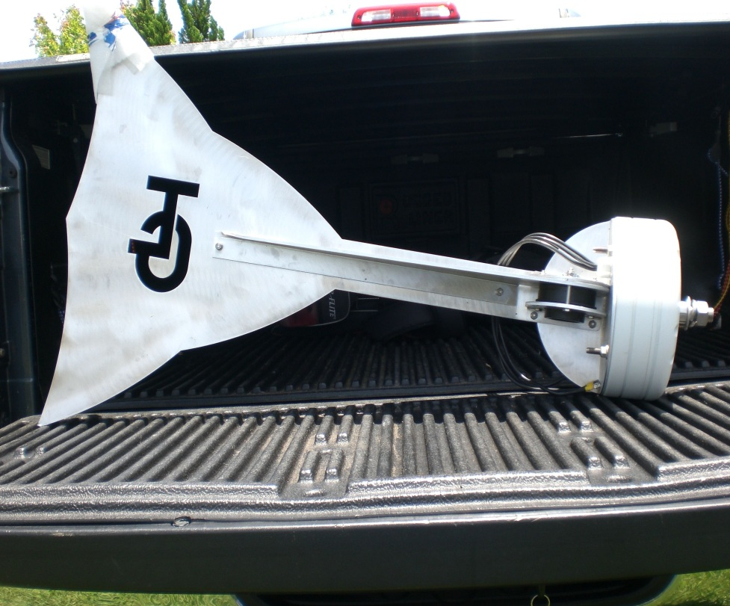
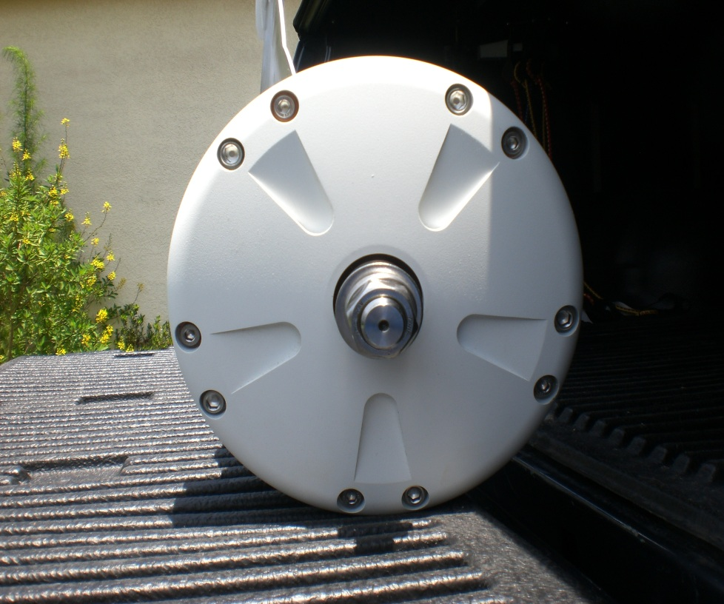
Wind Turbine
Length: 3’ 6”, Width: 2’ 4”, Diameter: 11”
Weight: 68lbs

Slide 7
Wind Generator
TLG 500 Alternator
  Rated at 500 watts
Wind Speed MPH +/- 2 | Amps into Battery Bank +/- 0.5 | Battery Voltage +/- 1 | Average Watts
7 MPH | 1 Amp | 24.0 Volts | 24 Watts
9 MPH | 2 Amp | 24.0 Volts | 48 Watts
15 MPH | 5 Amp | 24.8 Volts | 124 Watts
20 MPH | 10 Amps | 25.2 Volts | 254 Watts
25 MPH | 15 Amps | 26.8 Volts | 402 Watts
34 MPH | 23 Amps | 27.1 Volts | 623 Watts
40 MPH | 30 Amps | 28.2 Volts | 846 Watts
45 MPH | 39 Amps | 28.5 Volts | 1111 Watts
50 MPH | 50 Amps | 29.8 Volts | 1490 Watts

Slide 8
Charge Controller
3 Phase Rectifier
Buck Converter
Battery Bank
Interface Circuits
MOSFET Driver
MCU
Dummy Load
PWM
ON/OFF

Slide 9
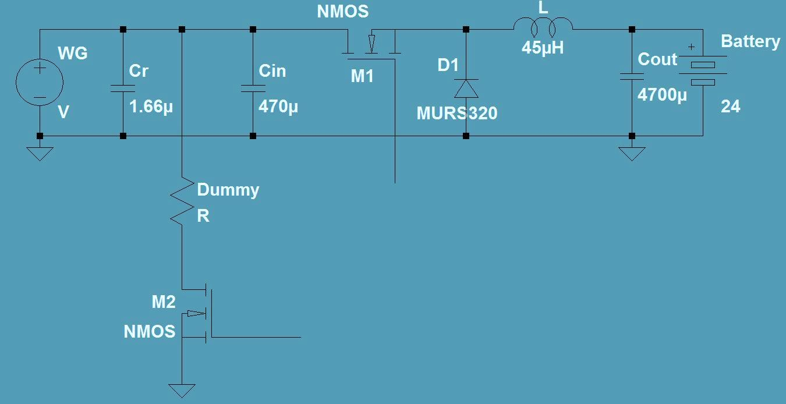
Charge Controller Design
MCU
Interface
Circuit

Slide 10
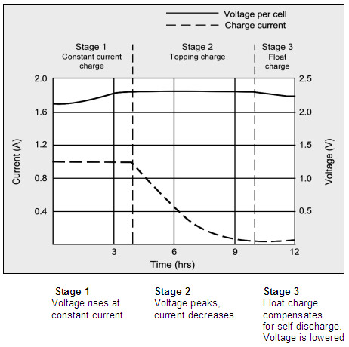

Charge Controller Design
Charging Stages
  Bulk charging stage
  Absorption stage
    $t=0.42\frac{C}{I}$
  Float stage

Slide 11
Maximum Power Point Tracking
Method
  Constant current method
Advantages
  No knowledge of the wind turbine characteristics
  No measurement of wind needed

Slide 12
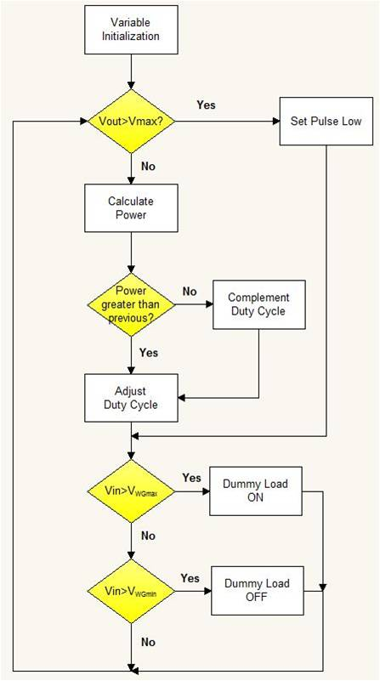
MPPT Flowchart
Microcontroller-based battery monitoring
When the battery reaches a set voltage a dummy load is used

Slide 13
MPPT Microcontroller
Two ATmega328P
  One used for MPPT algorithm
  MOSFET drivers
  PWM duty cycle adjustment
  Interacts with current and voltage sensors
  Second MCU used for data logging

Slide 14
MPPT Algorithm
Vout = a*Vin
  Vout > Vin
a = C, N
    C – Buck and Absorption constant
    N – Float constant

Slide 15
MOSFET Drivers
MIC5011
  Control the MOSFET for dummy load switching
IR2104
  Control the PWM duty cycle for the buck converter

Slide 16
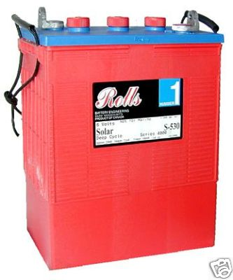
Battery Bank
12 & 24 Volt battery bank
Four 6V Lead Acid Flooded in series
Length: 12”, Width: 7”, Height: 17”
Weight: 127lbs
400Ah

Slide 17
Positional Control System
Was to be used for:
  Tracking wind direction and speed
  Preventing over-spinning of turbine rotor
  Servomotor
Ultimately not implemented

Slide 18
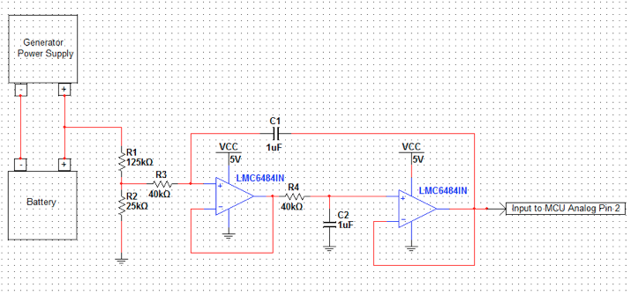
Voltage Sensor
Voltage divider circuit
2nd order Butterworth LPF
Cutoff frequency of 1 Hz and unity gain

Slide 19
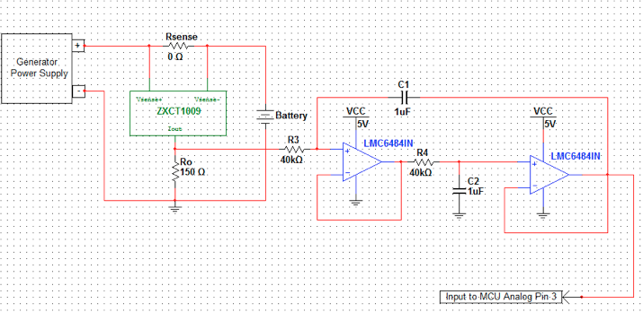
Current Sensor
LOB-5 0.01 Ohm Resistor
2nd order Butterworth LPF
Cutoff frequency of 1 Hz, unity gain

Slide 20
Data Logging MCU
Atmega328P
High performance
Low power consumption
28-lead PDIP
16 MHz at 4.5 – 5.5V

Slide 21
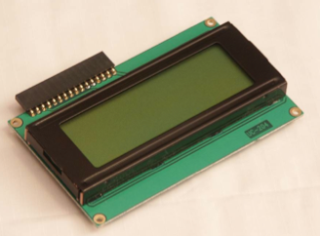
LCD Module
Hitachi HD44780
Four lines 20 characters wide
Low power consumption
Two main interface modes
  Four bits of data sent at a time
  Eight bits of data sent at a time.

Slide 22
PCB Design Software
Altium Designer 10
  Schematic capture
  PCB layout
  3D PCB
  FPGA development
  Embedded software
  Simulation
  CAM

Slide 23
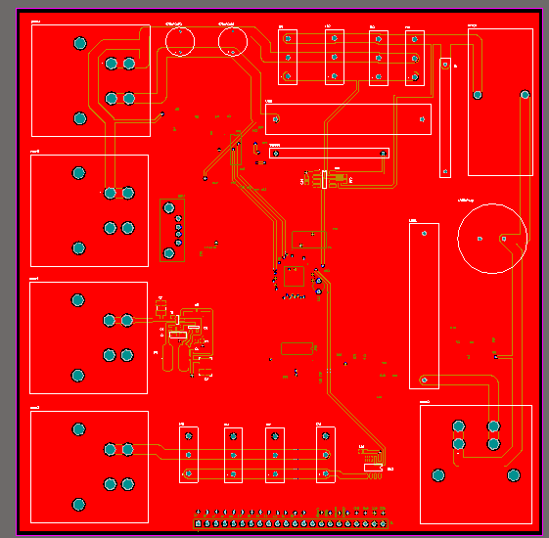
Initial PCB Layout
Top layer: High power elements, MOSFETs, and connectors
6 in. x 6 in.
4 oz. Copper traces

Slide 24
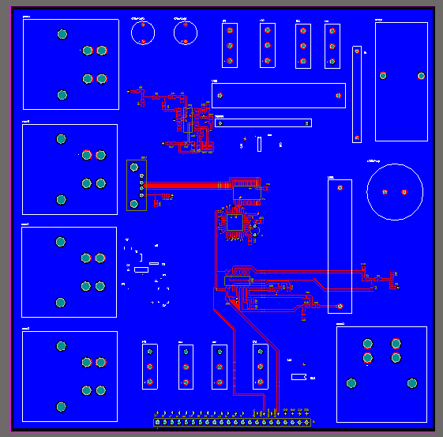
Initial PCB Layout (contd.)
Bottom Layer: Sensing circuits, filters, interface circuits
Atmel microcontroller in middle

Slide 25
Data Logging Subsystem
Analog Sensor Signal
Digitized Sensor Signal
Serial Data Variable
Plain text format
File on SD Card
Excel or equivalent
ADC
µC
Software
User
Software
Analog Inputs: Current & Voltage Sensors, RTC
Digital Inputs: Wind Speed Sensor, SD

Slide 26
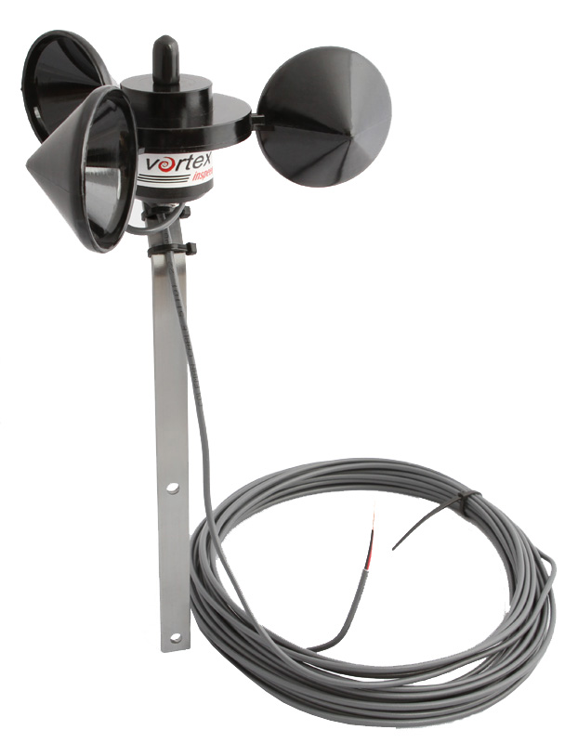
Wind Speed Sensor
InSpeed Vortex
  3-cup rotor
  Mounting bracket
  One pulse per rotation
  2.5 mph / Hz
  6” x 6” x 10”
  1.5 lbs

Slide 27
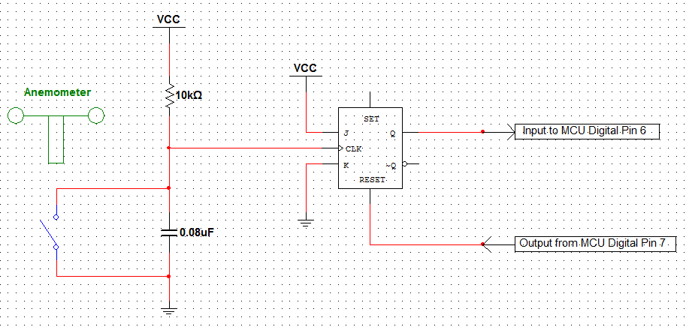
Wind Sensor Interface
Capacitor & pull-up resistor for debounce
Q defaults to high at each falling clock edge
µC resets flip-flop after each pulse

Slide 28
Data Logging Design
The second Atmel µC will be utilized
  Arduino bootloader
Begins logging only when SD is inserted
Will log these data in order:
  The present date (MM/DD/YY)
  The present time (HH:MM:SS)
  Wind speed (mph)
  Current from generator (A)
  Voltage in battery (V)
  Delimited by commas

Slide 29
Data Logging Peripherals
SD/MMC Socket
  Will utilize the open-source SD library
  Formatted for FAT32
  Safe Voltage Level: 3.3 V
MCP-1700-330
  Low-Dropout Linear Regulator
  5 V supply voltage to 3.3 V
  Used to prevent damage to the SD
  Level Shifter used to switch between 5 and 3.3 volt power supplies

Slide 30
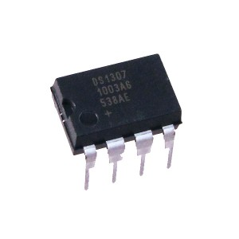

Data Logging Peripherals
DS1307 Real-time Clock
  $I^{2}$C interface to µC
  BCD Calendar & Clock
  Internal backup battery
  Accounts for leap years
Must be interfaced with the Atmel via the correct software libraries

Slide 31
Data Logging Routine
Interrupt-based
Interrupt subroutine runs at 5-second intervals
  Takes readings of current and voltage
  Accumulates over a 1-minute period
Wind speed pulses also counted
Variable Name | Variable Type | Description
chipSelect | int | Hardware chip select for SD card reader
windSpeedIn | int | Hardware pin that reads from wind speed sensor
windSpeedOut | int | Pin that resets JK flip-flop on wind speed sensor
currentSignal | int | Pin that reads from current sensor
voltageSignal | int | Pin that reads from voltage sensor
gLedIn | int | Green LED pin
rLedIn | int | Red LED pin
logTimer | int | Counter until data logging interval
logInterval | int | User-specified data logging interval
pulseCount | int | Counts pulses from wind speed sensor for a minute
checkPin | int | Poll windSpeedIn to check if can clear flip-flop
iSum | longint | Running sum of raw amperage signal readings from ADC3
vSum | longint | Running sum of raw voltage signal readings from ADC2
gLEDStatus | boolean | Green LED on or off
rLEDStatus | boolean | Red LED on or off
dataString | string | Forms plain text output to file on SD
dateTime | string | Time stamp value from RTC chip
windSpeed | float | Sensor constant * (pulseCount / minute )
iAvg | float | Calculated average of current signal readings over a minute
vAvg | float | Calculated average of voltage signal readings over a minute

Slide 32
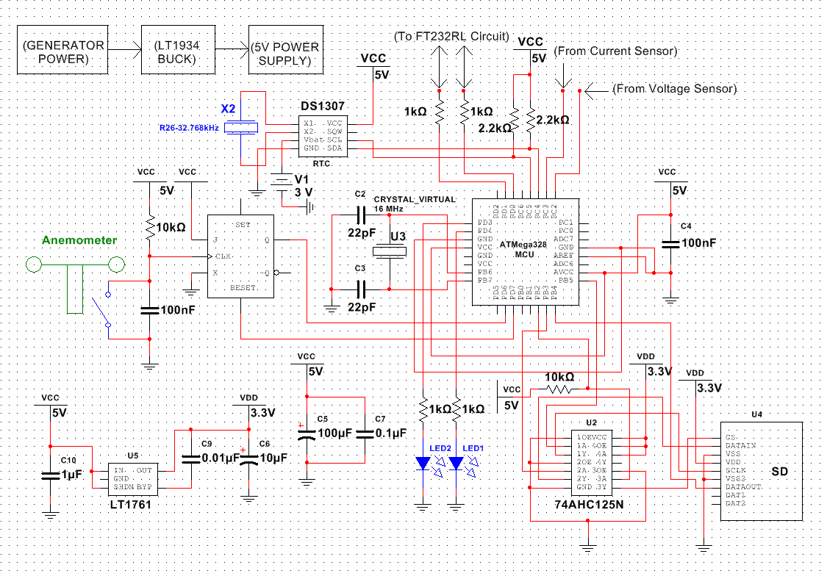
Data Logging Circuit

Slide 33
Work Distribution
Dwayne
Wind Turbine
Buck Converter
Joaquim
MPPT Algorithm
Charge Controller
Jose
Tim
Battery Bank
Wind Sensor
Data Logging Routine
Microcontroller Peripherals
PCB Design
Display
MOSFETs
Sensing Circuits

Slide 34
Bill of Materials
Part | Quantity | Cost
TLG 500 | 1 | $1575
Batteries | 4 | $1400
PCB | 2 | $120*
ATmega328P | 2 | $5
Display | 1 | $3
Regulators | 2 | $10
Wires/Connectors | - | $80
MOSFETs/Drivers | 7 | $7
V/I Sensors | 4 | $6
Wind Speed Sensor | 1 | $55
Misc. (Inductor, etc.) | - | $250
Total | - | $3511
Initial Budget | - | $4000

Slide 35
Complications
High power requirements
Difficulty of real world testing
Heat dissipation
Budget Concerns

Slide 36
Questions?

Slide 37
